Slide 1
Springboard Data Science Career Track - Capstone Project 2
Quality Measurement of NYC 311 Calls

Slide 2
Project Objectives
This project had two main objectives, a learning objective and a business objective.
Learning Objective:
This capstone project summarizes the knowledge and skills of program participants in the data science career track as demonstrated in the project workflow from data gathering, wrangling, analysis, summarizing, and recommendation for action plans.
Business Objective:
Through the use of real business data, findings and conclusions from this project are useful for NYC 311 public agencies to improve their service request resolutions

Slide 3
Methodology
The following methodology was adapted to assess performance of agencies resolving service requests from NYC 311:
Dataset: Identify where to find the required data and data retrieval
Data Wrangling: Once the data is identified and retrieved, basic data preprocessing and quality control are conducted
Data Exploration: When the data is ready for exploration, apply statistical methods to identify data clusters, correlations, and trends
Machine Learning for Prediction: With basic understanding of the data, more advanced data analytics of machine learning is applied to the data to build predictive models
Summary: conclusions and recommendations

Slide 4
Dataset
The dataset that was used is the “NYC Open Data 311 Service Requests from 2010 to Present”. The data was acquired by using the Socrata Open Data API (SODA) which provides programmatic access to the dataset. The original dataset contains 22.1 million rows and 41 columns, a total of 906.1 million data points. To make this training project more manageable in Python as well as more relevant to today’s status, a 50,000 row subset of the data from January 1, 2019 to January 15, 2019 was taken.

Slide 5
Data Problem
When people require non-emergency municipal services, the number to call is 311. In New York, all the data about 311 calls received in New York City is available online. A potential problem that can be addressed is the number of late incident resolutions. For each incident that gets reported, 311 creates a service request and notifies the appropriate agency with the request. A timeframe known as a service level agreement is created based on the type of request made, which informs the customer how much time it will take to respond to the request. Agencies are required to report their success resolving 311 service requests within the timeframe presented to customers
Some questions this dataset brought up:
Can we predict the likelihood a service request will be resolved after the estimated due date?
Can we improve estimates for service request resolutions?

Slide 6
Data Wrangling
Any extraneous data was removed
Columns containing only redundant data
Columns that held only descriptive information of the complaint
Columns that were specific to a certain complaint type like bridges and taxis
Features for Data Exploration and Machine Learning were identified and prepared
Converting dates to datetime
Grouping complaint, location, and open data channel types in order to reduce features
Encoding nominal values as dummy variables
Preparing the target column “late” by defining it as all cases closed after the estimated due date

Slide 7
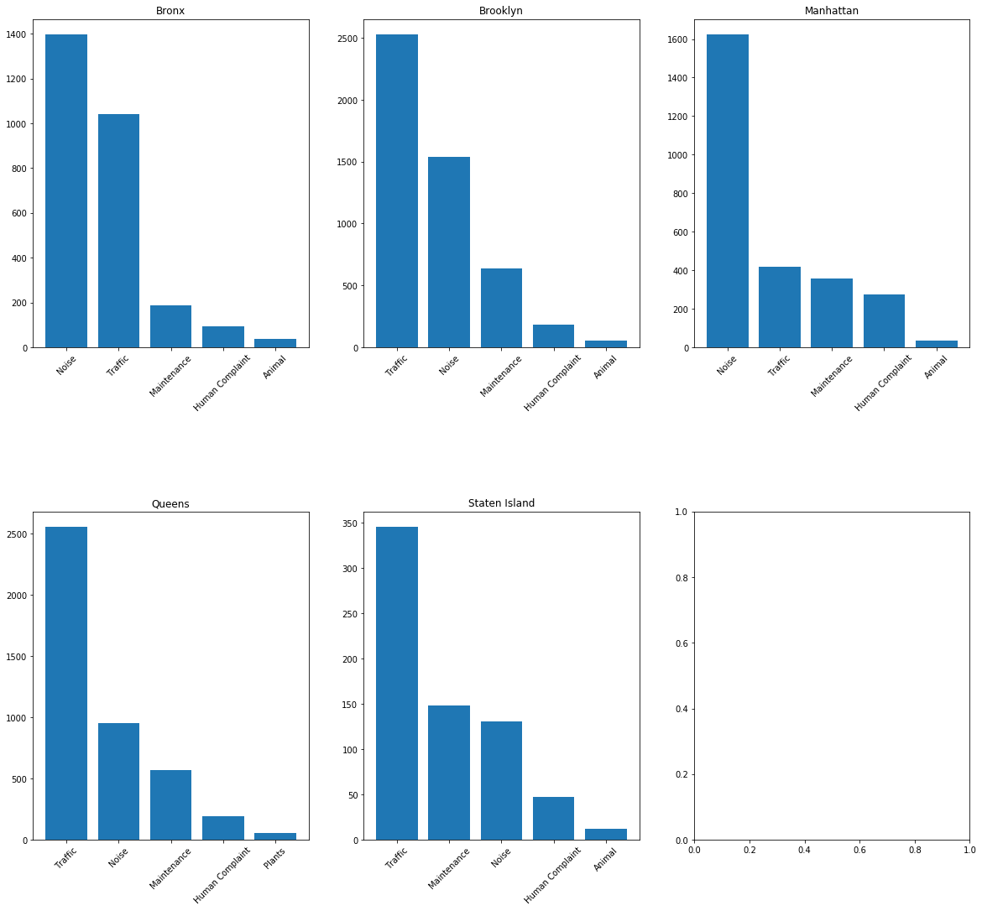
Data Exploration
There are quite a few variables that are of interest and can have an effect on the student’s final result in the course. Various independent variables were explored by examining correlations between independent variables and plotting bar graphs of the counts of those variables
Counts of the top five complaint types for each New York City borough are displayed to the right:

Slide 8
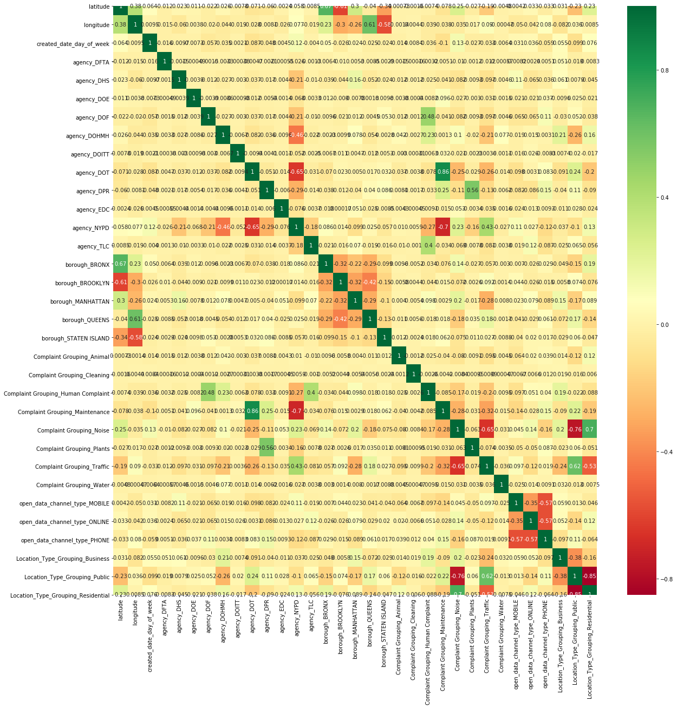
Correlation between Independent Variables
A few features seem to be correlated
Overall the feature variables appear to be independent
This leads us to a data question:
Can we predict if a service request will be resolved on time or not based on these independent variables?

Slide 9
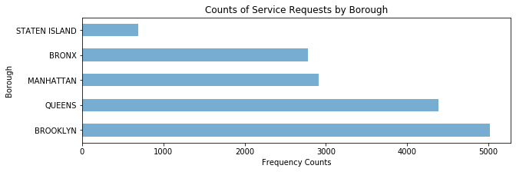
Data Exploration - Findings
Service requests are well represented by each borough

Slide 10
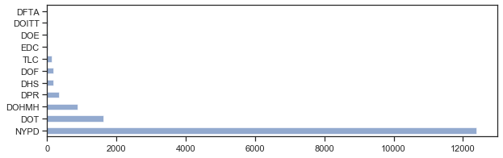
Data Exploration - Findings
A few agencies appear to not have many service requests, could affect the outcome of the study.

Slide 11
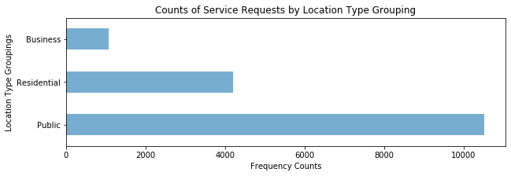
Data Exploration - Findings
The location type of the service requests in the dataset seem well represented

Slide 12
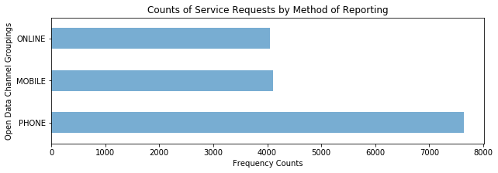
Data Exploration - Findings
The methods by which service requests are reported appears to be relatively evenly distributed

Slide 13
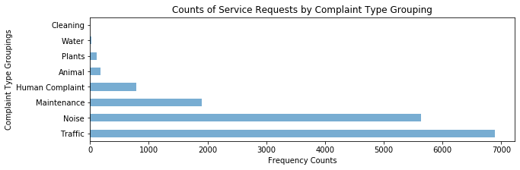
Data Exploration- Findings
Cleaning and Water labels seem underrepresented in the dataset. Could affect interpretation of results.

Slide 14
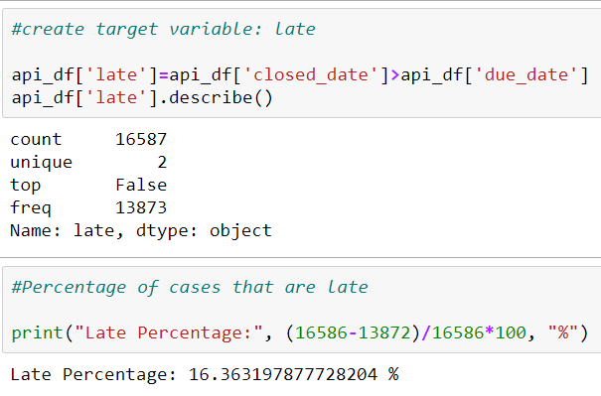
Data Exploration - Findings
16% of the cases in the subset were resolved after the estimated resolution date of the request

Slide 15
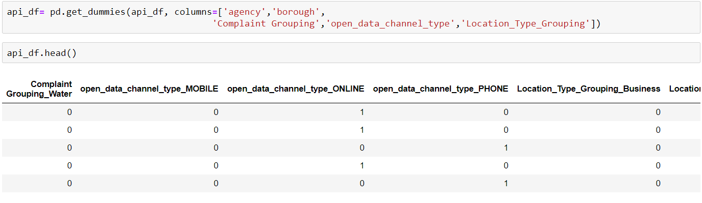
Data Analysis - Machine Learning
To prepare for machine learning, a one hot encoding was done to create binary variables out of the scalar variables for machine learning modeling.

Slide 16
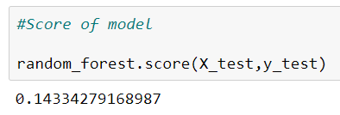
Machine Learning
As the goal of the data analysis is to classify service request resolutions as late or not, a supervised machine learning classification method seems appropriate. A Random Forest Model and a Logistic Regression Model were built on the dataset. The score of the random forest was low, so more emphasis was placed on the logistic regression model.
Score of random forest model

Slide 17
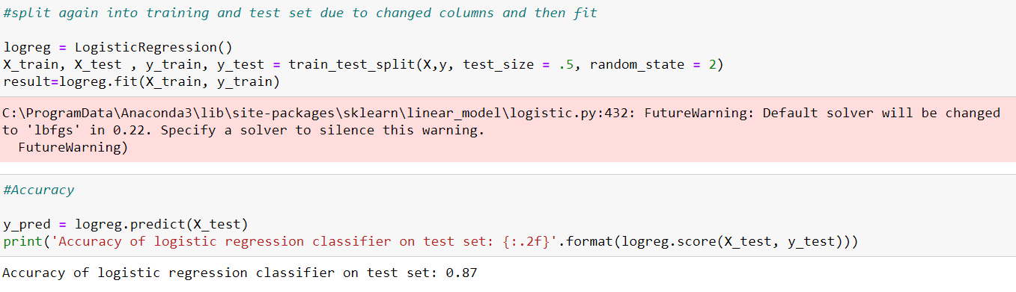
Machine Learning
After choosing the logistic regression model built on the training set. We used the test set to check to see how our model was performing. Accuracy of 0.87 was noted.

Slide 18
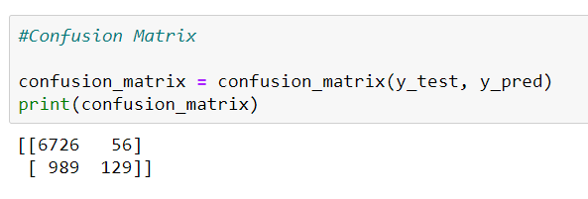
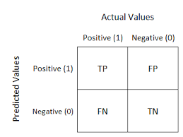
Machine Learning - Confusion Matrix
The confusion matrix shows how the model performed on the test set.

Slide 19
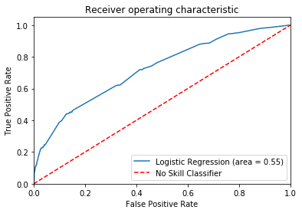
Machine Learning - Logistic Regression AUC-ROC Curve
AUC -ROC curve: ROC is a probability curve and AUC represents degree or measure of separability. It tells how much the model is capable of distinguishing between classes. The dotted line represents a no-skill classifier that cannot discriminate between the classes and predicts labels randomly or as a constant class. The area under the curve was reported as 0.55, and the f1 score was 0.20. With a large AUC, the model is strong at predicting late calls as late.

Slide 20
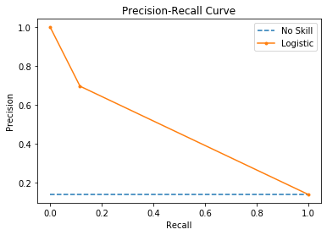
Machine Learning - Precision Recall Curve
Precision describes how good a model is at predicting the positive class, in this case if a service request is resolved ‘late’ or not. Recall is sensitivity, or the number of true positives divided by the sum of the true positives and the false negatives.For our dataset, the curve depicted above represents a skillful model because the curve bows towards (1,1) (a model with perfect skill) above the flatline of no skill.

Slide 21
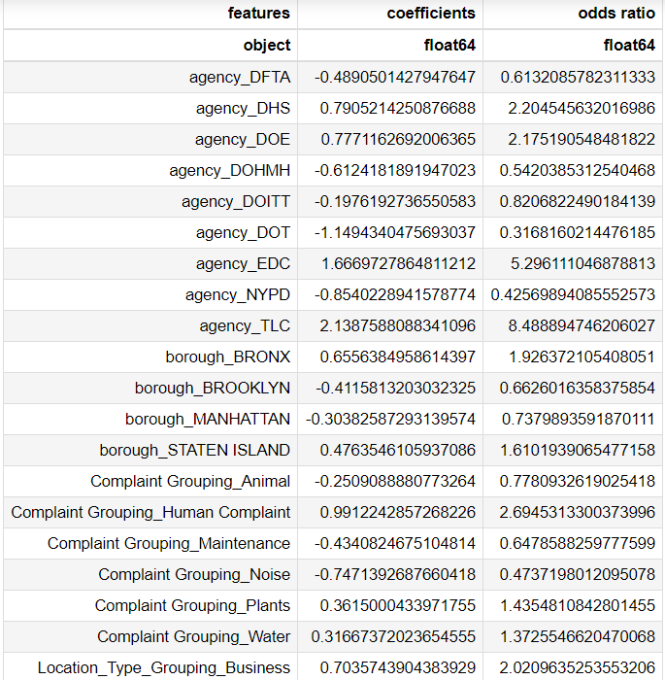
Results
The table to the right shows the coefficients of logistic regression and odds ratios for each feature in the dataset. The odds ratio shows the increase or decrease in likelihood of a service request being resolved if all other features are kept constant.
The largest odds ratio seen belonged to calls handled by the Taxi and Limousine Commission with a 849% increase in probability of a call being labeled as late according to the model.
The feature with the lowest odds ratio belong to calls handled by the New York Department of Transportation. These cases were 68% less likely to result in a label of “late” according to the model.

Slide 22
Conclusion
With the machine learning model built in this project, features which contributed to predicting whether or not a service request would be resolved on time or not were identified.
This information is useful for New York City agencies to improve their service and performance. The model suggests that the Bronx and Staten Island require more attention from public agencies, whereas service requests originating in Manhattan and Brooklyn were resolved much quicker.
An improvement to the model created in this project would be to train the model on a much bigger subset of the data. 50,000 rows were taken from the NYC Open Data 311 website, but 22.1 million rows of data exist.

